Slide 1


Department of Artificial Intelligence and Data Science
Event Management System
Santhosh B
(221801046)
Sriraam GV
(221801052)
Buvankalyan P
(221801506)

Slide 2
Problem Statement
The current event planning landscape is increasingly complex, requiring a digital solution that simplifies booking and provides personalized, efficient services. Traditional methods lack instant results, seamless user interaction, and robust data security, which are essential in today's tech-savvy world.

Slide 3
Objectives
This study aims to develop a user-friendly event management website that simplifies planning and booking by integrating an AI-powered chatbot for interactive guidance. With encrypted data storage to ensure security, the platform will also automate booking confirmations for immediate user feedback. Ultimately, it will serve as an all-in-one solution, offering diverse event services to meet a wide range of needs efficiently.

Slide 4
Abstract
This project aims to create an efficient event management platform that leverages technology to streamline the planning and booking processes. By integrating a chatbot, secure data handling, and automated confirmation, the system enhances user experience, data security, and booking efficiency. It presents a modern solution for the fast-evolving event management industry.

Slide 5
Introduction and Overview of the Project.
The project introduces a secure and interactive event management website designed to meet the rising demands for digital solutions in event planning. It integrates an AI-driven chatbot, secure login, and encrypted data storage, facilitating a smooth and personalized user experience for planning and booking events like weddings, corporate functions, and social gatherings​

Slide 6
LITERATURE REVIEW
S.No | Author Name | Paper Title | Description | Journal | Volume/ Year
1. | Ananya U., Shetty K. U., Shraddha H. M., Priya P., Dr. Joseph M. J. V. | Event Management System for Educational Institutions | Web-based event management for institutions with event creation, tracking, and feedback. | International Journal of Creative Research Thoughts (IJCRT) | 2022
2. | Madhuri Dubey, Vinay Mishra, Priya Banarjee, Ajvita Jumle, Pallavi Raipure, Pooja Wankhede | Event Management System | Online event management for booking, availability, and efficiency. | International Journal of Trend in Research and Development (IJTRD) | 2016

Slide 7
LITERATURE REVIEW
S.No | Author Name | Paper Title | Description | Journal | Volume/ Year
4. | MohanaS., Mr.P.Anbumani | Online Event Management System | Design of a digital platform for online event management. | International Journal of Research Publication and Reviews | 2022
5. | Drahsti Amrish Shah, Hemalata Vasudavan, Nurul Farhaini Razali | Event Management Systems (EMS) | Web-based application for event management development and implementation. | Journal of Applied Technology and Innovation | 2023

Slide 8
Existing System
Event Management System is a Java-based web application that allows users to view, book, and organize events. It supports three main user roles: administrators, event organizers, and customers.
The application is built using HTML, CSS, and Bootstrap for the front end, while Java with the Spring MVC framework powers the backend. MySQL is used for storing all the information related to users, events, and bookings.
This system is not a automated system it is full manual

Slide 9
Advantages and Disadvantages of Existing System
Limitations of Existing System:
Limited Scalability: The current system may struggle to handle a large number of concurrent users and event due to its architecture.
Manual Event Approval: Event approval by administrators is a manual process, which can slow the overall workflow.
Features of Existing System:
User Roles and Managements
Event Browsing and Booking
Personalized Recommendations
Secure Payment Processing
Centralized Database
User feedback

Slide 10
Proposed System
Intuitive User interface: Provides a seamless and responsive desing for easy navigation and efficient event management
Comprehensive Event Management: Enable event discovery, registration, and organization with integrated tools and smart Recommendations
Secure Payment Gateway Facilitates secure and encrypted transactions for event registration and organizational fees
Scalable Architecture Built on a Robust, Scalable framework with MySql for flexible data management and future growth

Slide 11
Advantages and Disadvantages of Proposed System
Features of Proposed System:
Personalized Event Recommendations
Automated event planning assistance
Dynamic budget optimization
Enhanced users experience
Limitations of Proposed System:
Data Privacy and Security Concerns
AI model Dependency and Bias
Scalability Challenge with Real-time Processing
Integration Complexity with External Services

Slide 12
SYSTEM REQUIREMENTS
Software Requirements :
Frontend: HTML, CSS, JavaScript, React.js, Bootstrap.
Backend: Node.js, Express.js.
Database: MySql for data management and encryption.
Chatbot Integration: Dialogflow or Rasa for AI-powered guidance.
Security: JWT for authentication, BCrypt.js for password hashing, SSL certificates.
Payment Gateway: Stripe or PayPal for secure transactions.
Email Service: Nodemailer for booking confirmations.

Slide 13
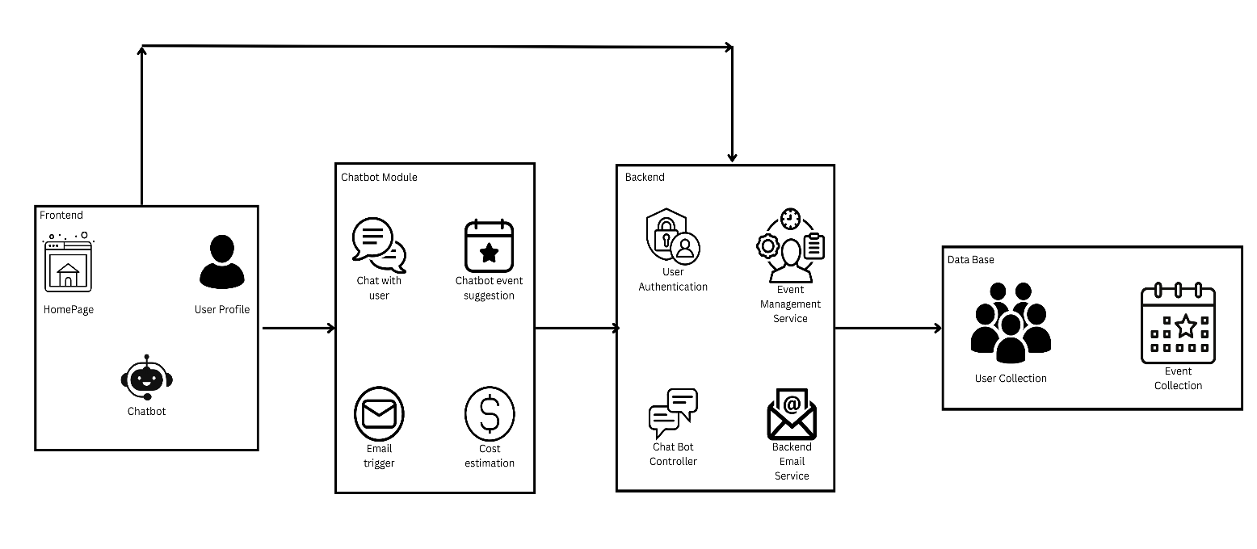
System Architecture

Slide 14
List of modules
1. User Authentication Module
2. Chatbot Module
3. Event Selection and Customization Module
4. Data Encryption Module
5. Admin Dashboard Module
6. Email Notification Module

Slide 15
User Authentication Module
The User Authentication Module flowchart provides a structured approach for managing user access, incorporating both new user registration and existing user login. New users initiate the process through registration, where they create a password that is encrypted and stored securely to prevent unauthorized access. This step ensures that user credentials are protected, laying the foundation for secure account management. Additionally, if users forget their password, a password reset mechanism is available, allowing them to securely regain access without compromising their account's security.

Slide 16
Chatbot Module
The Chatbot Interaction Module flowchart outlines a structured user engagement process. It begins with an initial greeting, after which users can follow two main paths: interaction or preference collection. In the interaction path, the chatbot conducts a question-and-response flow, offering event type and service suggestions and guiding users through navigation. In the preference collection path, it gathers user preferences for selecting services like venue, catering, and decor, while also providing real-time assistance for FAQs and queries. This design enables personalized support, helping users make informed decisions efficiently.

Slide 17
Event Selection and Customization Module
The Event Selection and Customization Module flowchart outlines a process for planning and personalizing events. It begins with selecting the event type (e.g., wedding, corporate, social gathering) and proceeds to choose a venue based on location and capacity. Users can then set decor preferences, such as theme and style, with dynamic updates provided in real time. Simultaneously, the module enables service options selection, including catering customization (menu, dietary needs) and additional services (e.g., entertainment). Finally, a summary presents an overview of all selected choices, ensuring a comprehensive event plan tailored to user preferences.

Slide 18
Data Encryption Module
This flowchart outlines a "Data Management and Encryption Module" that securely handles user data. It starts with Data Storage in MongoDB, followed by Data Encryption to protect sensitive information. Access Control enforces role-based authorization, while Privacy Compliance ensures adherence to data privacy standards. Parallel processes include Data Retrieval for module access, Data Modification for updates, and a Data Integrity Check to maintain consistency. The module emphasizes security, access control, and data integrity.

Slide 19
Admin Dashboard Module
This flowchart represents a "Booking Confirmation and Payment Module" that handles booking finalization and payment processing. It begins with Booking Finalization and Payment Verification for authentication and fraud detection, followed by Booking Confirmation and Confirmation Dispatch via email or notification. Parallelly, Payment Processing is secured, with Transaction Recording and Confirmation Details Recording storing payment and booking summaries. This module ensures secure transactions and efficient booking confirmation.

Slide 20
Email Notification Module
This flowchart depicts an automated email and notification module for bookings. After a booking is completed, a confirmation email with a summary and receipt is generated and sent to the user’s registered email. A phone verification SMS or notification is also triggered, followed by a summary that tracks delivery status and resends notifications if needed.

Slide 21
Software Testing: Event Assistant Chatbot Website
The Event Assistant Chatbot website underwent comprehensive testing to verify its functionality, usability, and performance. The purpose of this testing was to ensure that the chatbot meets the intended user experience goals and operates smoothly under various conditions. Functional testing was conducted to confirm that core features, such as sending messages, responding to commands (like "Participate" and "Arrange"), and handling both long and empty inputs, work as expected. All functional test cases passed successfully, indicating that the chatbot performs its core tasks reliably.
Usability testing focused on the chatbot’s responsiveness and user interface. Tests included verifying the chatbot's adaptability across devices, the alignment and accessibility of buttons, and ease of input. Minor accessibility issues were found, particularly with screen reader compatibility, which could be improved to enhance the experience for users with disabilities. Performance testing involved measuring the chatbot's response times under both normal and high-load conditions. The chatbot consistently met acceptable response times, averaging 1.8 seconds under normal load and remaining under 5 seconds even with simulated high load. During extreme, high-frequency input, the response time slightly increased but remained stable without crashes.

Slide 22
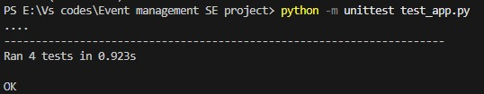
Software Testing: Event Assistant Chatbot Website (Output)

Slide 23
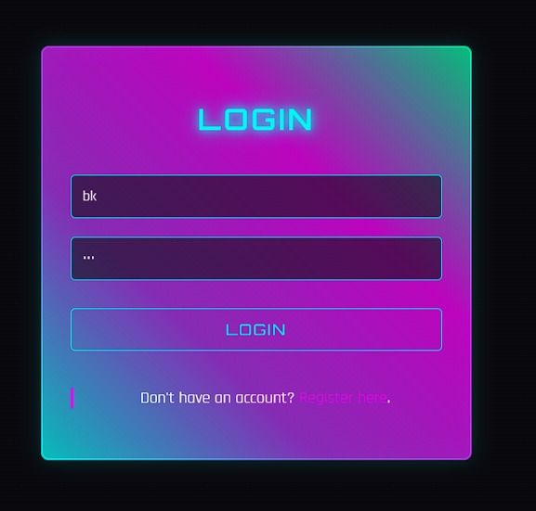
Visualization of Results

Slide 24
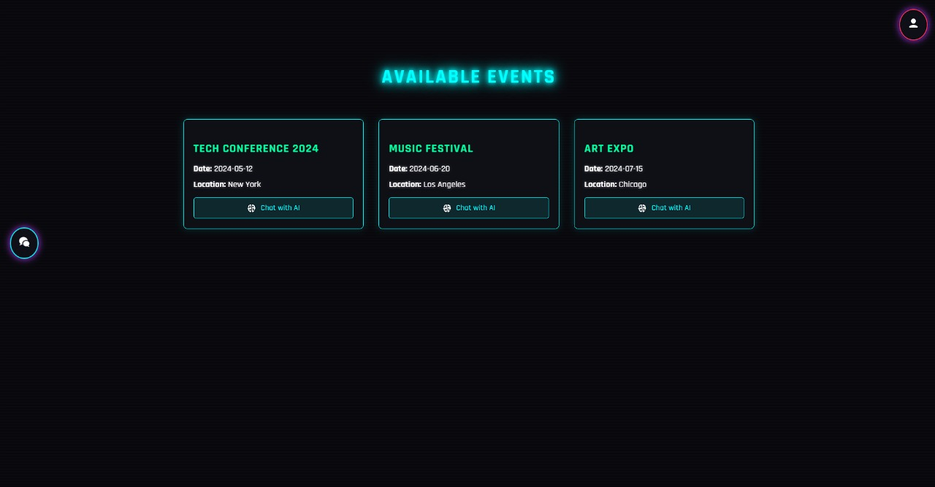
Visualization of Results

Slide 25
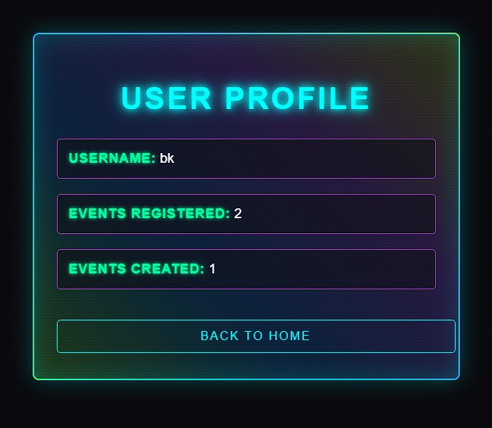
Visualization of Results

Slide 26
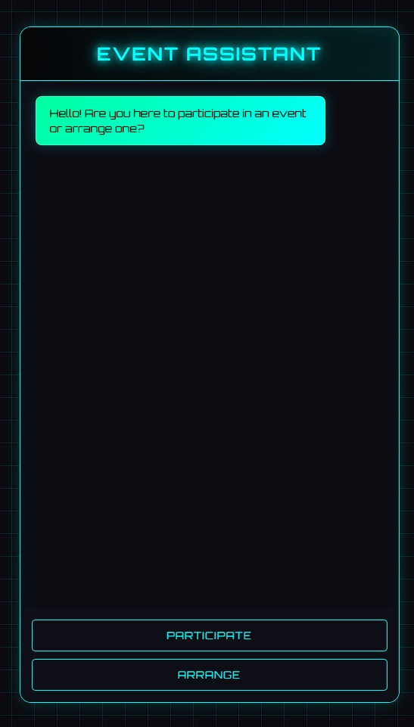
Visualization of Results

Slide 27
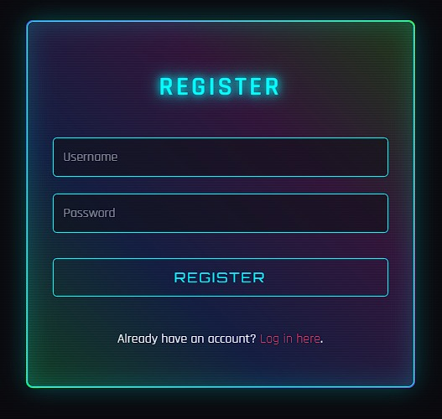
Visualization of Results

Slide 28
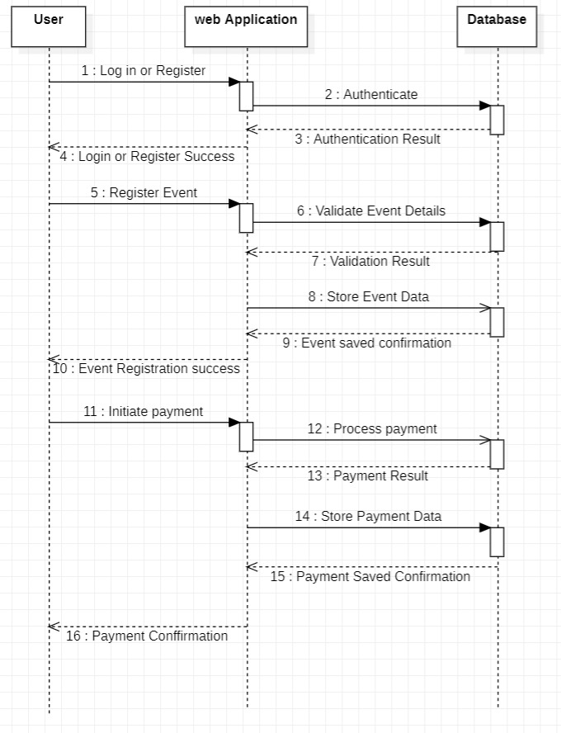
Sequence Diagram

Slide 29
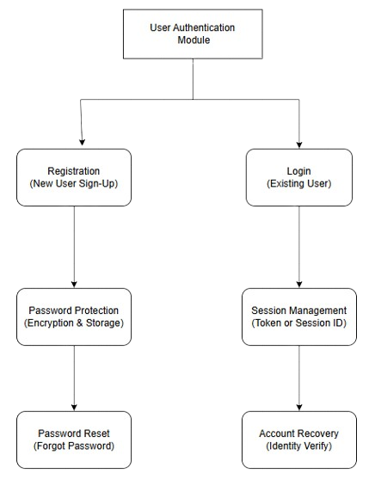
User Authentication Module (DFD Level 1)

Slide 30
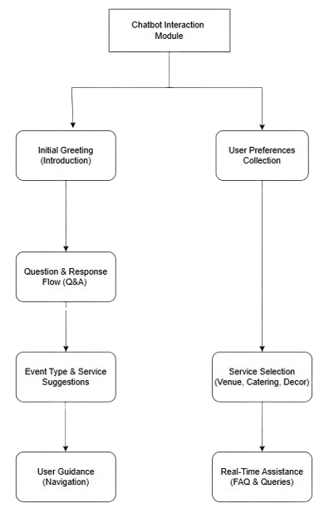
Chatbot Module (DFD Level 1)

Slide 31
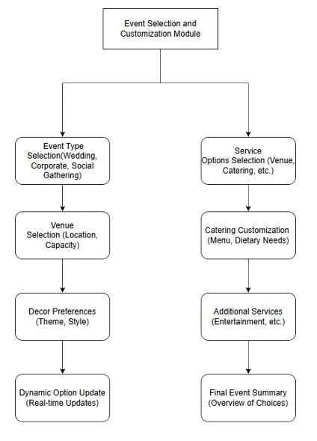
Event Selection and Customization Module (DFD Level 1)

Slide 32
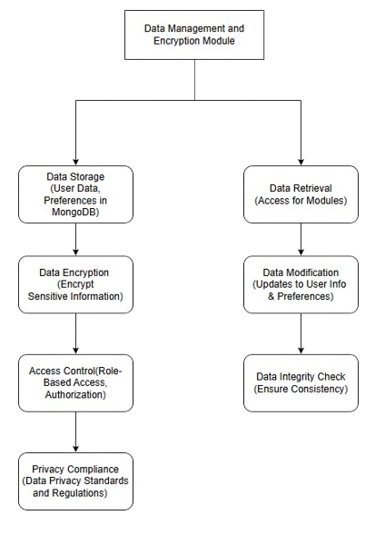
Data Encryption Module (DFD Level 1)

Slide 33
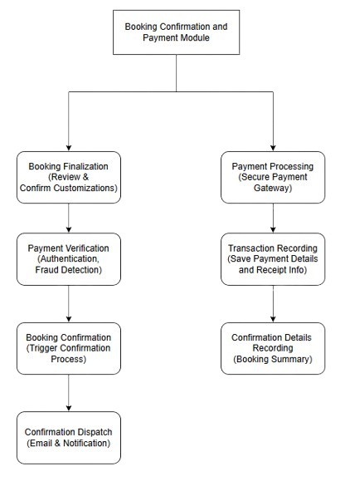
Admin Dashboard Module (DFD Level 1)

Slide 34
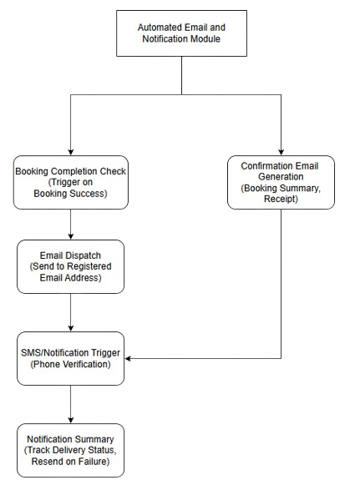
Email Notification Module (DFD Level 1)

Slide 35
Result and Discussion
The platform successfully implements secure user authentication, encrypted data handling, and interactive chatbot support. User testing shows high satisfaction, with efficient event management processes and streamlined booking workflows. The chatbot and admin dashboard significantly improve user interaction and system management, while scalability and performance metrics highlight the platform's robust design

Slide 36
Conclusions
The project achieves its objectives by simplifying the event planning process through a secure, interactive platform. It enhances the user experience and meets market demands for a digital event management solution. Future work could include enhanced chatbot capabilities, mobile app development, and additional

Slide 37
References.
[1] Ananya, U., Shetty, K. U., Shraddha, H. M., Priya, P., & Joseph, M. J. V. (2022). Event Management System for Educational Institutions. International Journal of Creative Research Thoughts (IJCRT), 10(3), 560-568.
[2] Kumar, A., & Singh, S. (2019). Securing Online Event Management Platforms with Encrypted Databases. International Journal of Computer Applications, 182(28), 21-27.
[3] Shah, D. A., Vasudavan, H., & Razali, N. F. (2023). Event Management Systems (EMS): Development and Implementation. Journal of Applied Technology and Innovation, 4(1), 15-22.
[4] Dubey, M., Mishra, V., Banarjee, P., Jumle, A., Raipure, P., & Wankhede, P. (2016). Event Management System. International Journal of Trend in Research and Development (IJTRD), 3(4), 120-124.

Slide 38
Thank You

